Slide 1

Sales Efficiency
with
Lead Conversion

Slide 2





Agenda
Navigating Our Approach to Predictive Lead Conversion
The Challenge
Our Solution & Approach
Key Findings & Impact
Conclusion & Next Steps

Slide 3

Addressing Inefficiencies in B2B Lead Conversion
In the highly competitive B2B sales landscape, marketing and sales teams dedicate significant resources to acquiring new leads.
However, a major challenge lies in the fact that a large number of these leads—often over 70%—do not become paying customers, which results in wasted effort and a diminished return on investment

Slide 4
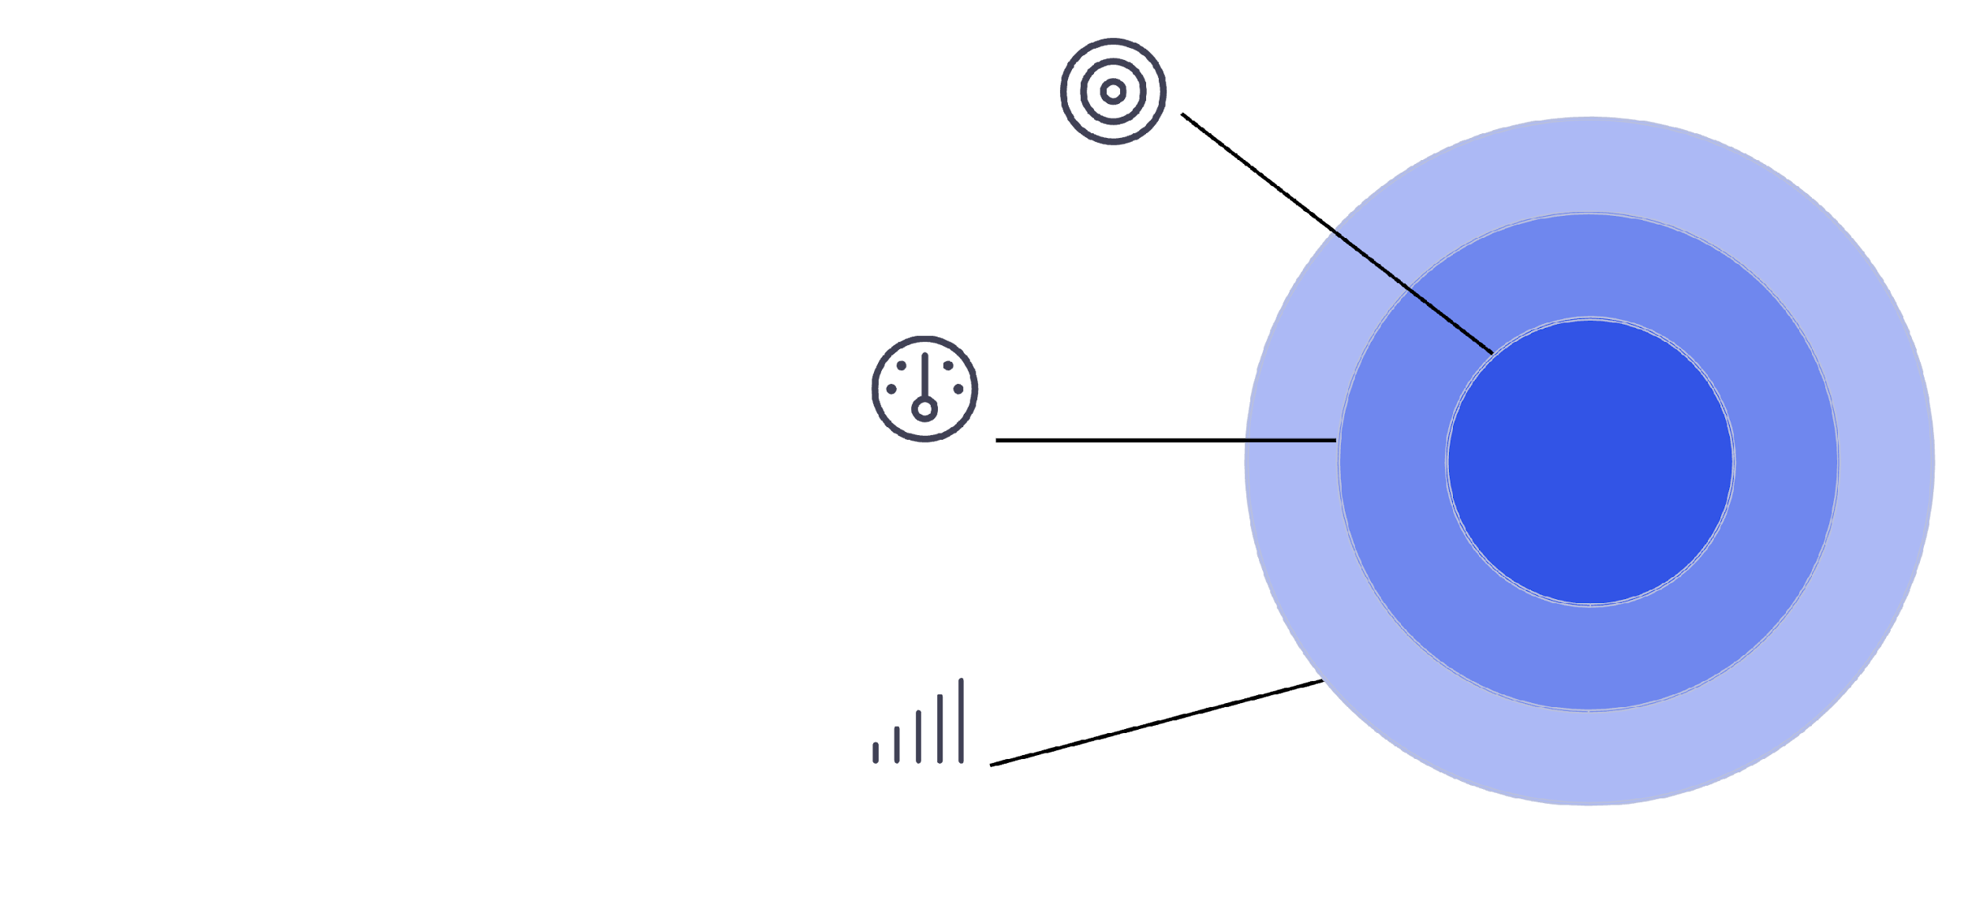
Project Objective: Predictive Lead Scoring with Machine Learning
High Potential
Our core objective is to architect and deploy a robust classification model that generates a precise probability score for each incoming lead.
By leveraging algorithms like Logistic Regression or Gradient Boosting, we can facilitate the dynamic.
By classifying leads into high, medium, and low potential, sales teams can strategically prioritise their efforts, significantly enhancing conversion rates and overall sales effectiveness.
Medium Potential
Low Potential

Slide 5

Project Scope & Methodology
Our project followed a structured data science methodology, beginning with data preprocessing, where we addressed missing values through imputation and handled outliers to ensure data quality.
This was followed by comprehensive exploratory data analysis (EDA) to uncover initial insights.
The core of our work involved intensive feature engineering, creating new predictive variables and transforming existing ones using techniques like one-hot encoding for categorical data
Key Phases:
Data Acquisition & Cleaning-
Feature Engineering
Business Insights & Integration
Model Selection & Training
Performance Evaluation

Slide 6
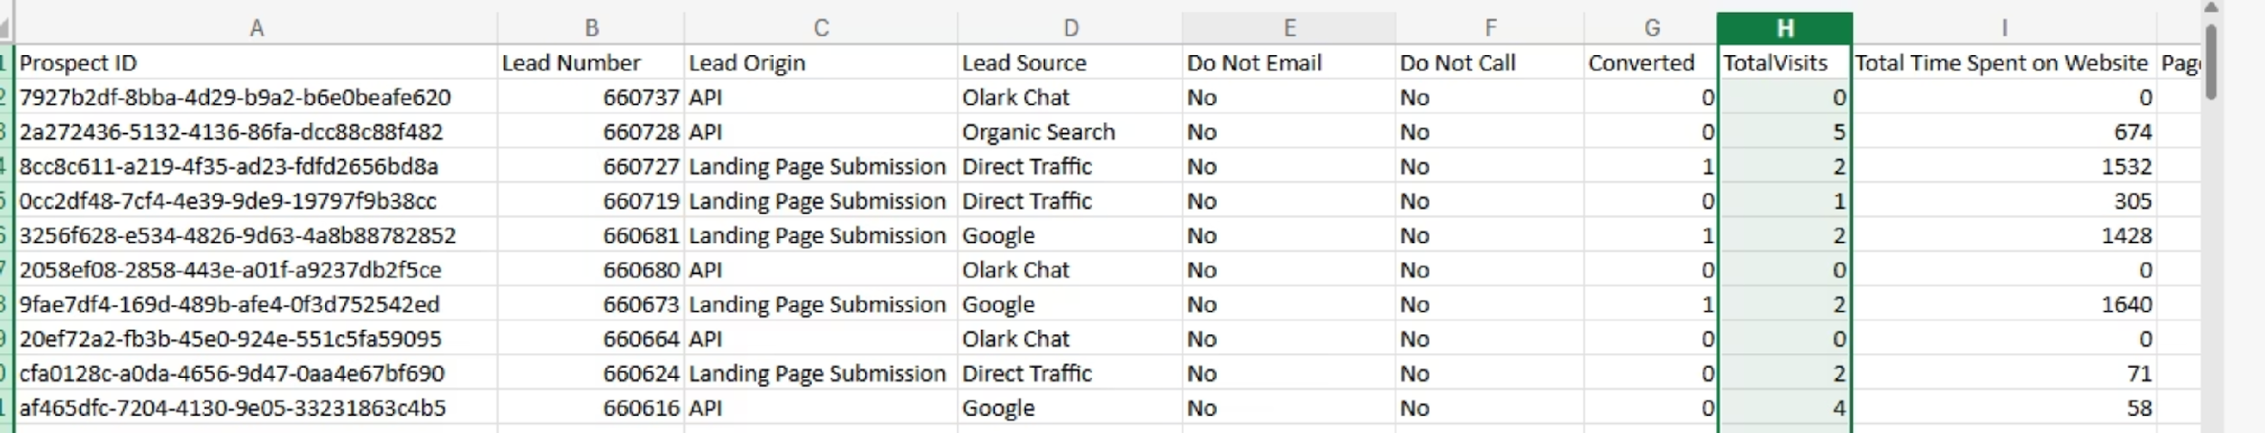
Dataset Overview: X Education Lead Data
The dataset for this project provides a comprehensive view of each sales lead, combining unique identifiers like 'Prospect ID' and 'Lead Number' with a rich array of behavioral and demographic attributes. It includes over 30 variables that capture the lead's journey and profile.
Lead Source and Origin: Information on how the lead was acquired, such as 'Lead Origin' (e.g., API, Landing Page Submission) and 'Lead Source' (e.g., Google, Olark Chat).
Engagement Metrics: Quantitative data tracking user interaction, including 'TotalVisits', 'Total Time Spent on Website', and 'Page Views Per Visit'.

Slide 7
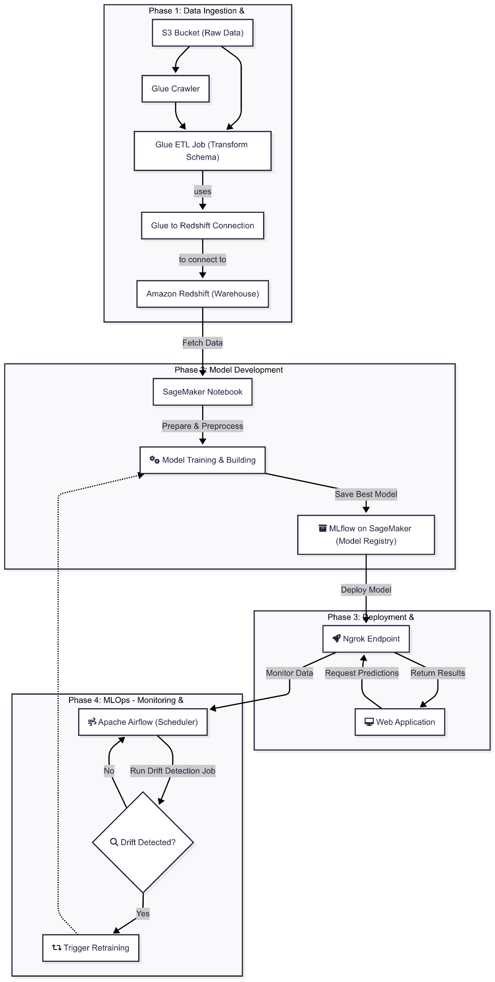
Data Architecture:

Slide 8



Model Building & Training:
After rigorous data preprocessing, including handling missing values and encoding categorical features, we engineered new features like 'Engagement Score'. We experimented with various classification models, including Logistic Regression, Random Forest, and Gradient Boosting. XGBoost consistently outperformed others in accuracy and robustness, establishing itself as our optimal model.
Data Cleaning & Imputation:
Feature Engineering:
Model Selection & Tuning:
1.)Label/One-Hot Encoding
1.) Random Forest
1.)Remove duplicates
2.) Feature Mapping
2.) XGBoost
2.)Handle missing data
3.)Scale or normalize numerical features
3.)LightGBM
3.)Outlier detection

Slide 9

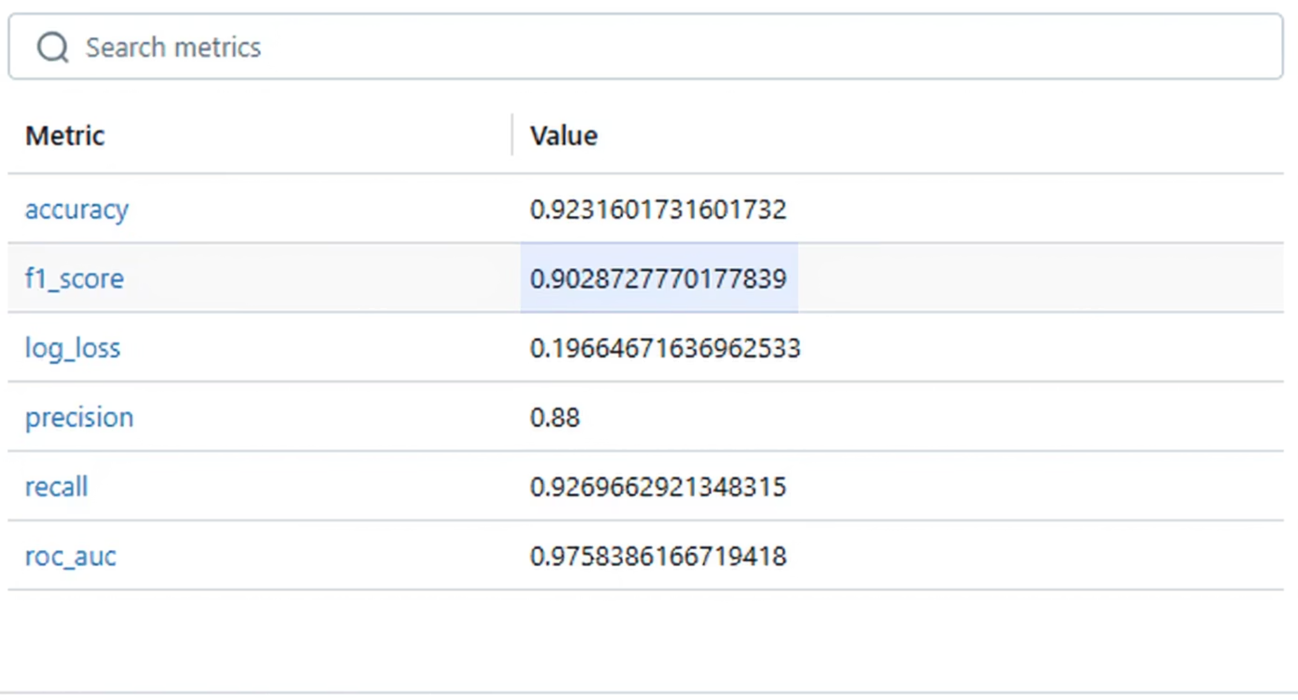
Model Evaluation: Superior Performance with LightGBM
The LightGBM model demonstrated exceptional performance across key metrics. It achieved an accuracy of 92%, a recall of 92%, and an F1-score of 90%, indicating its strong predictive power and ability to minimise false negatives. The ROC AUC score of 0.97 further confirmed its excellent discriminatory capability between converting and non-converting leads.

Slide 10
Conclusion & Next Steps: Towards Smarter Sales
This project successfully delivered a robust predictive model that directly addresses the core business problem of identifying high-potential sales leads. By classifying prospects based on their likelihood to convert, this data-driven solution empowers the sales team to move beyond reactive lead handling and focus their efforts where they matter most
Immediate Impact:
Future Enhancements:
Reduced Effort on Low-Quality Leads
CRM Integration for Automation
Enhanced Sales ROI
Real-time Lead Prioritisation
Data-Driven Sales Strategies
Continuous Model Retraining

